Slide 1
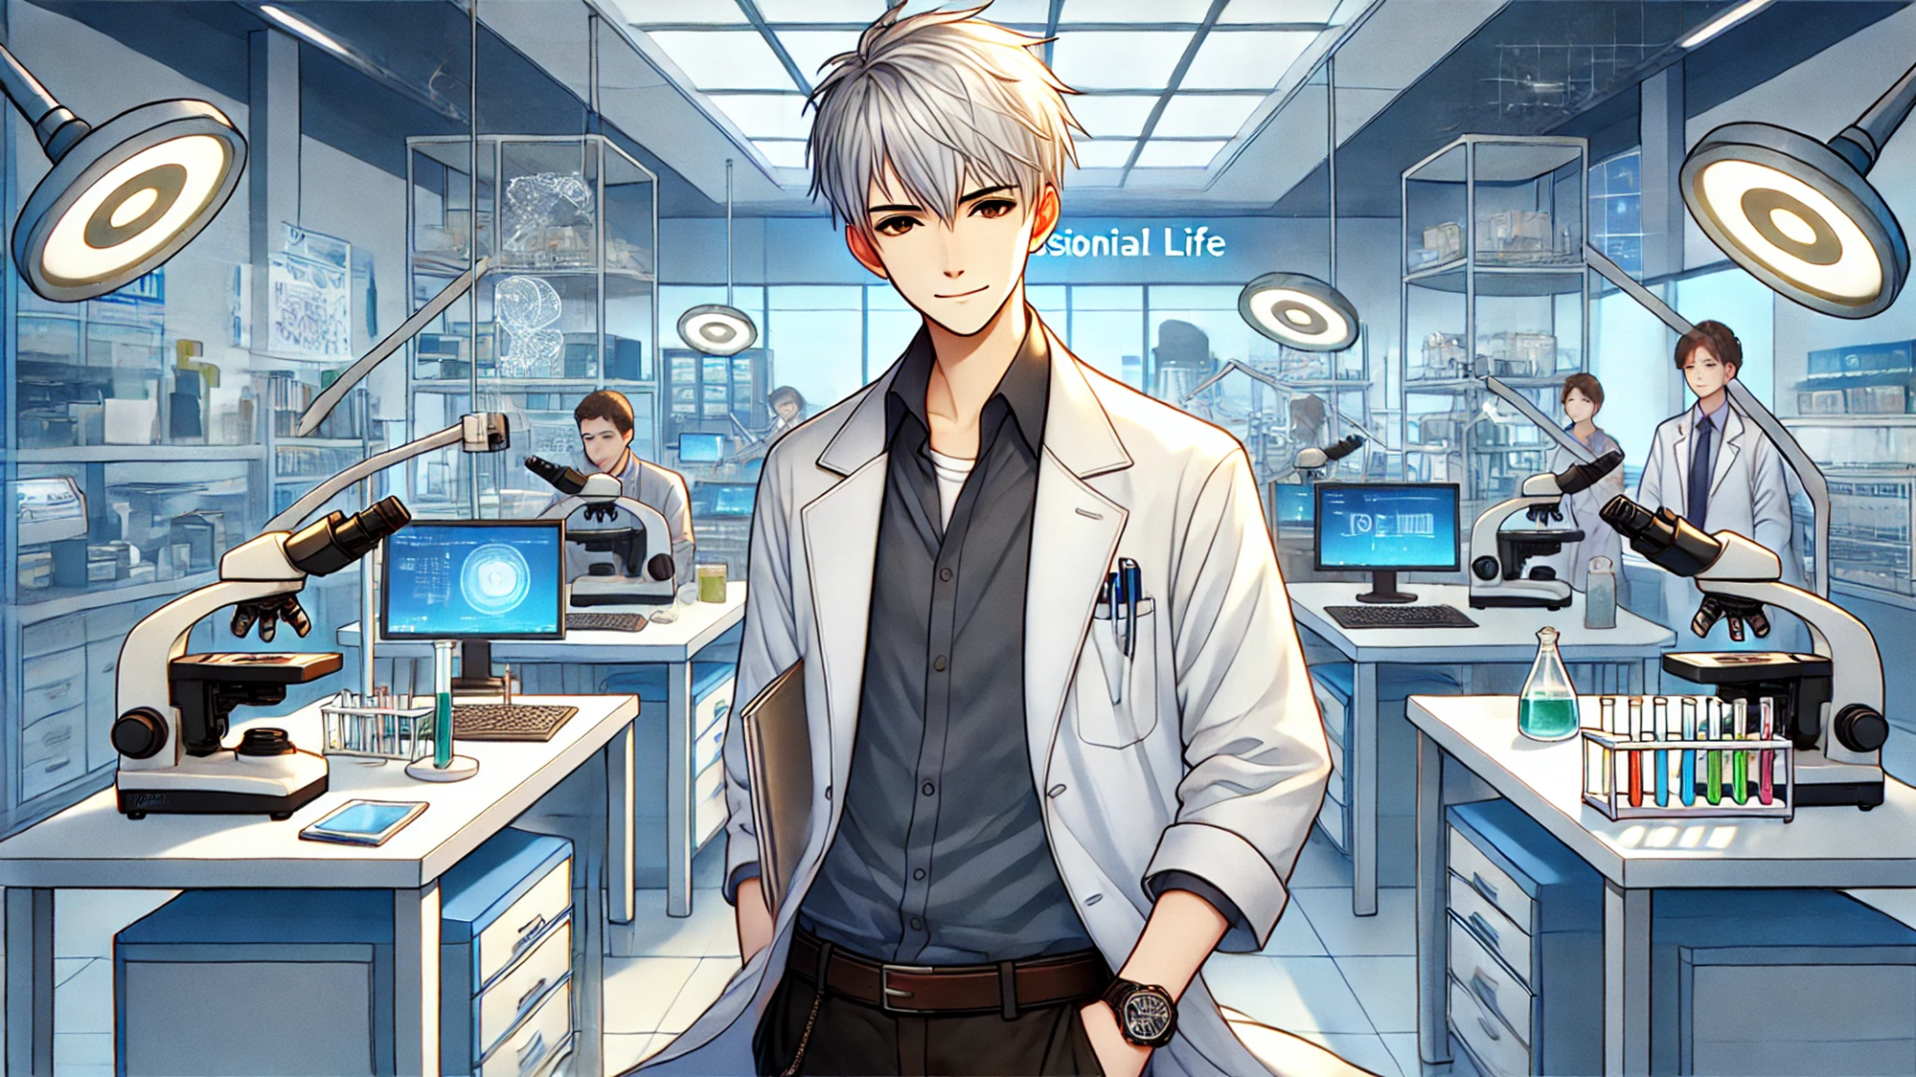
白法醫的職場生活(Animaze)
Notes:
【Prompt】
Create a modern laboratory scene with a confident young scientist standing in the foreground, wearing a white lab coat and holding a clipboard. The lab has advanced equipment like microscopes, test tubes with colorful liquids, and computer screens displaying research data. Behind him, other scientists are focused on their work. The lighting is bright and clinical, with a futuristic atmosphere, while the overall mood is professional and dedicated, showcasing a day in the life of a scientist.
【Context】
哈囉~我是小白，今天來說職場故事啦~~
【Reference】

Slide 2

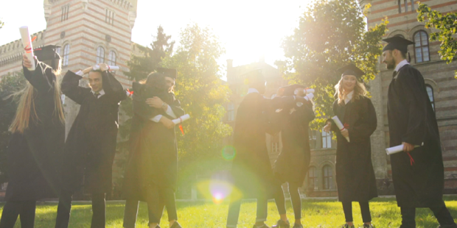
目標
Notes:
【Prompt】
Generate a vibrant and joyful graduation ceremony scene in an elegant auditorium filled with students in blue and gold graduation gowns and caps. The central character is smiling proudly, holding a diploma in one hand with a medal and ribbon on their chest. The background showcases cheering crowds of family and friends, grand columns, red banners, and confetti floating in the air. The atmosphere is festive, with sunlight streaming through large windows, creating a warm and celebratory mood.
【Context】
小白終於順利畢業，成為一名法醫，帶著滿腔的熱情進入了一家知名的法醫實驗室。
他的第一個任務是參與一起疑難的凶殺案調查。這是他一直夢想的職業生涯，卻也充滿了挑戰。
【Reference】
https://www.freepik.com/free-video/multi-ethical-happy-graduates-hugging-congratulating-each-other-cheerfully-their-graduation-day-front-university_478776#fromView=search&page=1&position=2&uuid=719c934d-5d69-43db-ab6c-a4f6066fd173

Slide 3
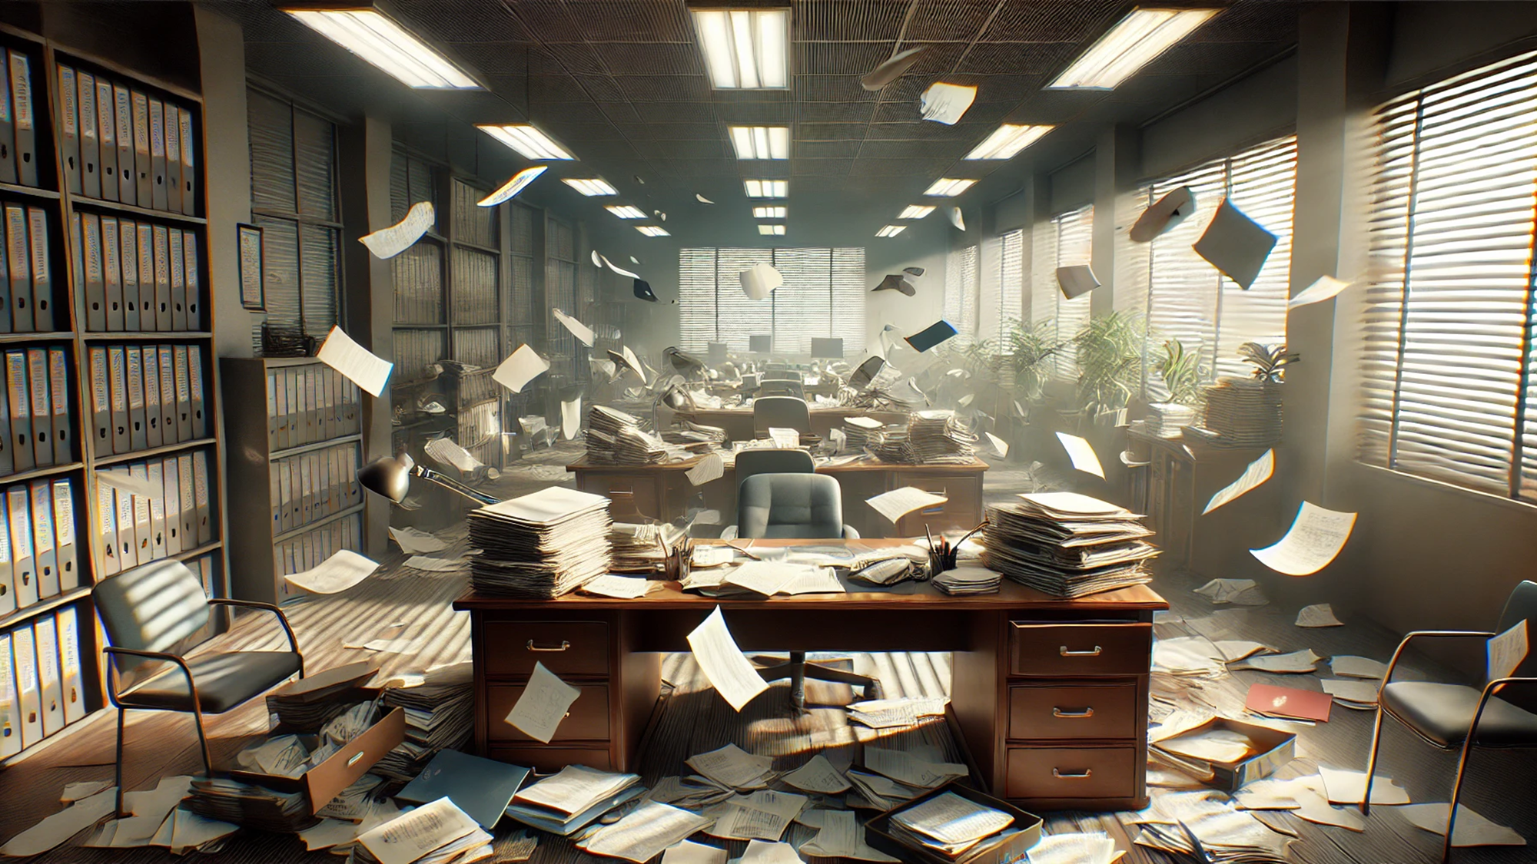
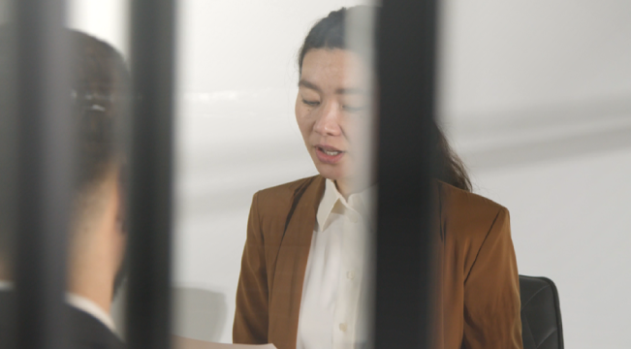
阻礙
Notes:
【Prompt】
Create a chaotic office scene where papers and documents are scattered in the air as if by a strong gust of wind. The office is large and open with desks covered in stacks of paperwork, folders, and files. Filing cabinets line the walls, filled with neatly labeled binders, but the room looks disorganized. Sunlight streams in through the windows, casting strong shadows across the room. The overall atmosphere is one of disruption and urgency, as if something unexpected has caused the mess.
【Context】
在調查過程中，小白面臨了許多阻礙。案件資料混亂，同事們對於他的年輕和缺乏經驗有些質疑。
【Reference】
https://www.freepik.com/free-video/male-candidate-being-interviewed-office-job-by-female-interviewer-viewed-through-window-3_887219#fromView=search&page=1&position=0&uuid=19fbb5e2-81ad-4ff4-b97a-1025f6bb7f2e

Slide 4
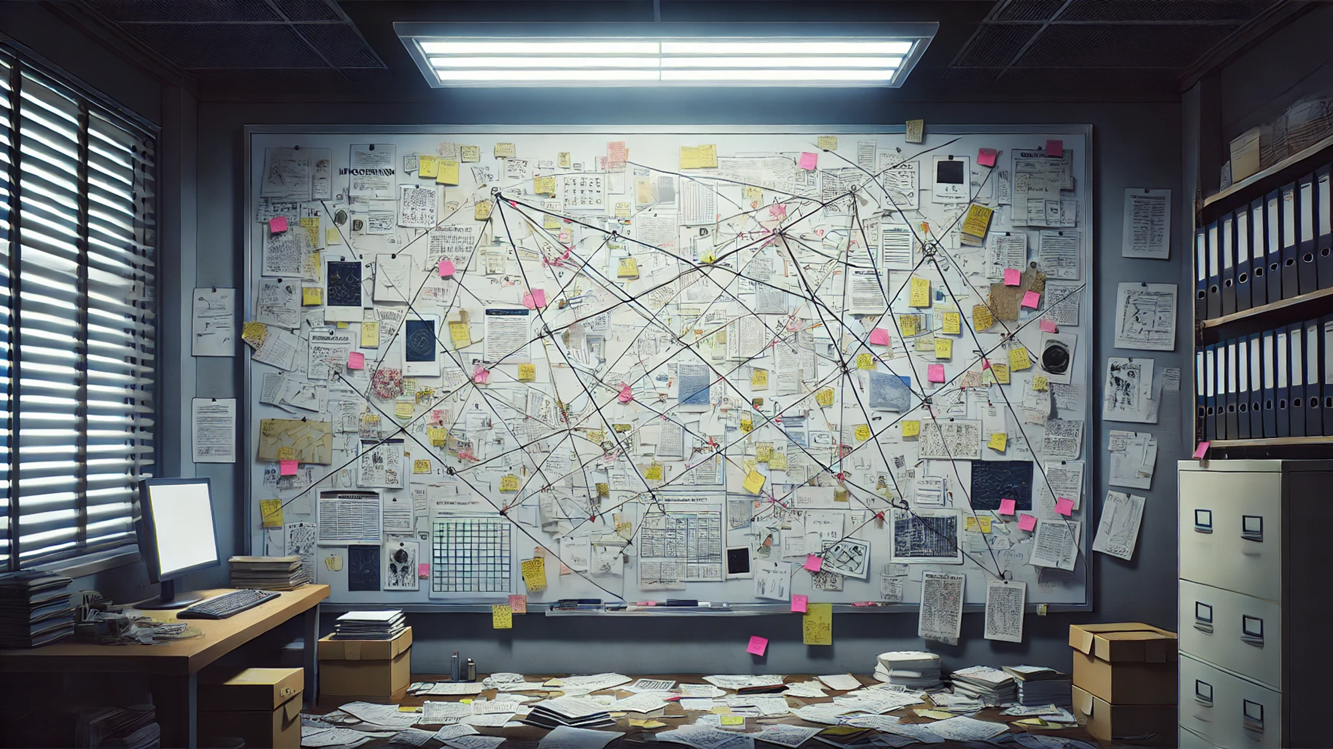
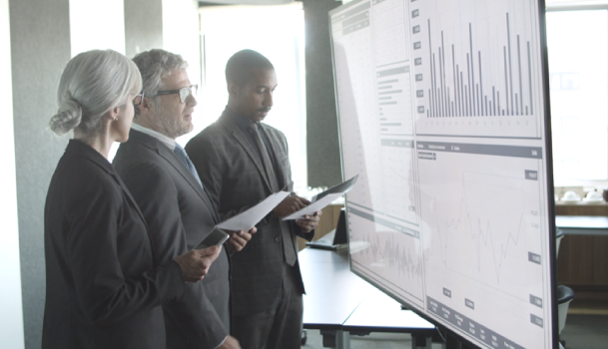
努力
Notes:
【Prompt】
A highly detailed anime-style investigation room filled with an overwhelming amount of clues and documents. The focal point is a large whiteboard completely covered with papers, sticky notes, and various diagrams, all connected by crisscrossing strings of yarn in a chaotic web of connections. The floor is littered with scattered papers and files, and a desk to the side holds a computer, stacks of documents, and boxes filled with case materials. The room is dimly lit by overhead fluorescent lights, casting a stark, clinical glow over the scene. On one side, tall shelves packed with organized binders and files line the wall, indicating a vast amount of research and data collection. The blinds on the window are partially drawn, letting in a thin beam of natural light that contrasts with the cold, methodical atmosphere. This room exudes a sense of intense focus and obsession, as though a massive conspiracy or mystery is being unraveled.
【Context】
儘管如此，小白決心不放棄，他利用自己在校園時期學到的技能，仔細分析每一個細節。
【Reference】
https://www.freepik.com/free-video/business-traders-meeting-room-with-data-screen_473833#fromView=search&page=1&position=6&uuid=ff931172-363a-451a-be2f-fa78e8a4c2e3

Slide 5
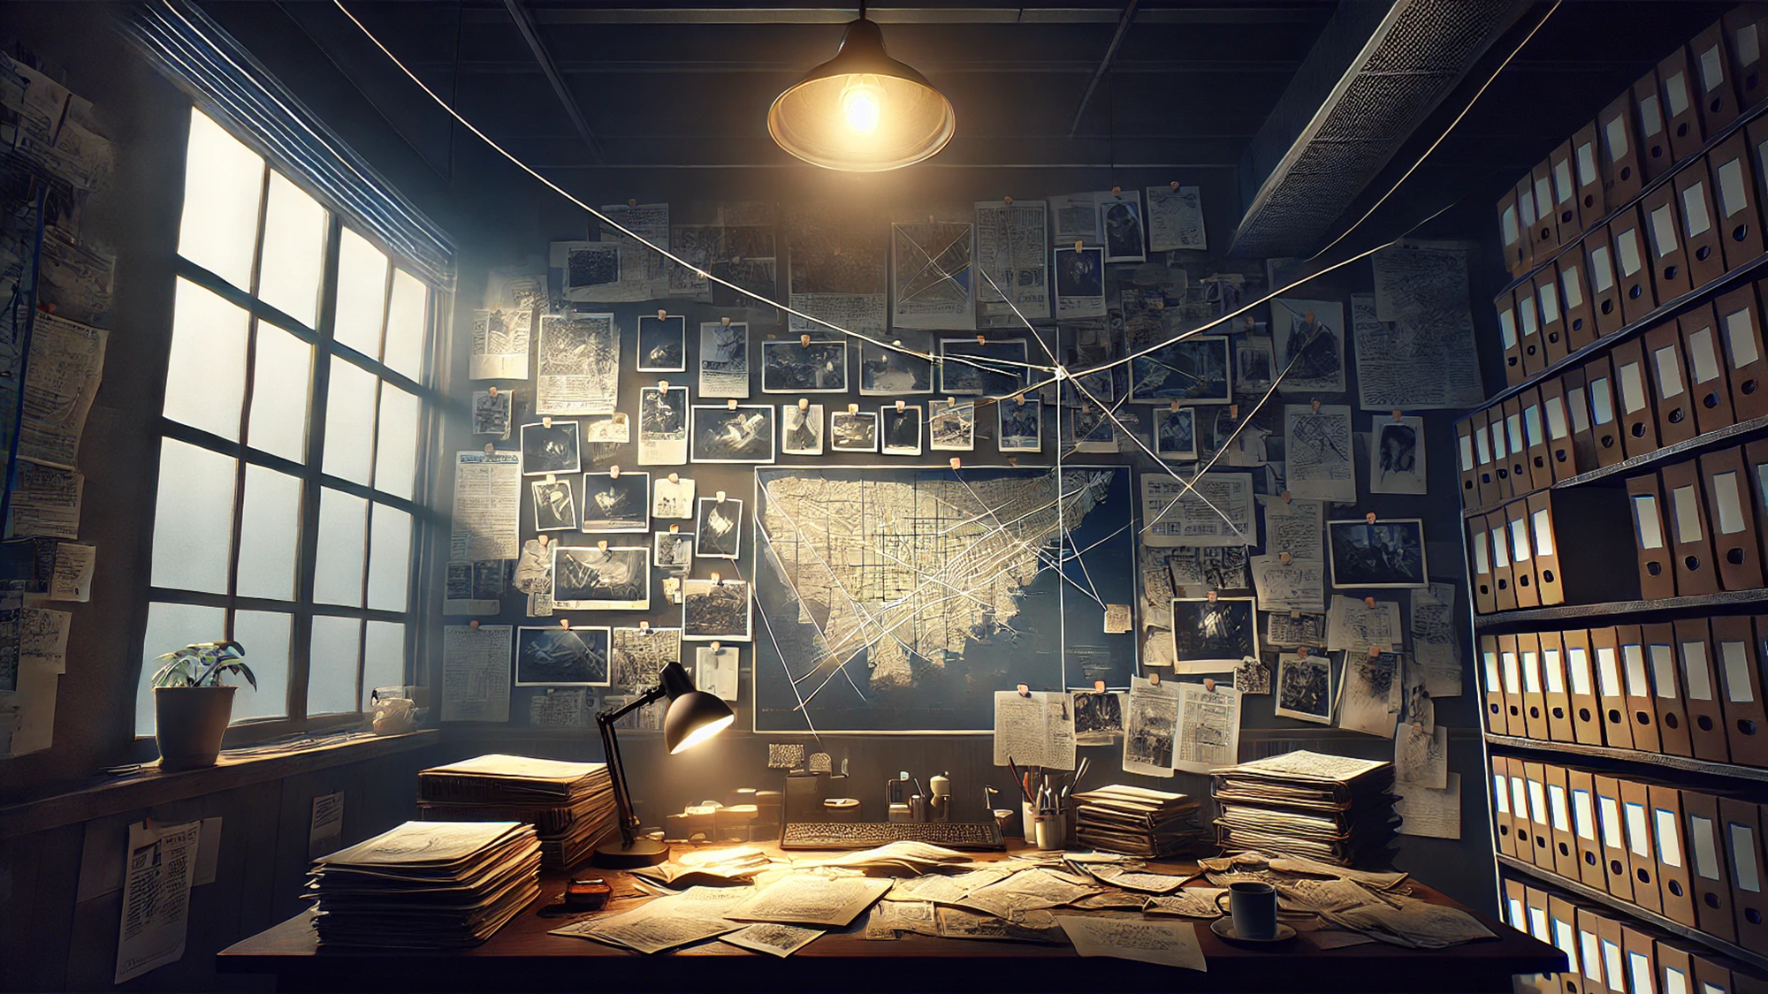
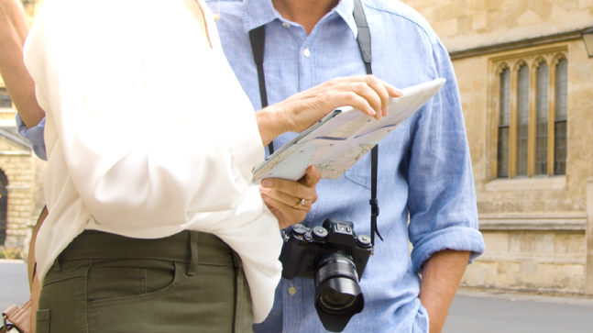
結果
Notes:
【Prompt】
An anime-style investigation room with a dark, moody atmosphere. The scene is centered around a cluttered desk filled with papers, files, and a lamp casting a dim glow across the workspace. The back wall is covered with maps, photographs, and documents, all connected by strings of yarn, suggesting a deep, complex investigation in progress. Stacks of folders and boxes filled with files are neatly arranged on shelves to the side, emphasizing the scope of the research. The room feels tense and focused, with light filtering in from a large window, casting shadows and adding a mysterious tone to the scene. The chaotic arrangement of evidence on the wall tells a story of an investigator or detective working tirelessly to piece together a puzzle, evoking a sense of urgency and intrigue.
【Context】
隨著深入調查，他發現一個關鍵的證據，這證據的發現讓案件有了重大突破。
【Reference】
https://www.freepik.com/free-video/mid-section-tourist-couple-reading-map-street_77144#fromView=search&page=1&position=9&uuid=59bc6a6f-c2ea-4199-b1f6-52b5f4aa96a9

Slide 6
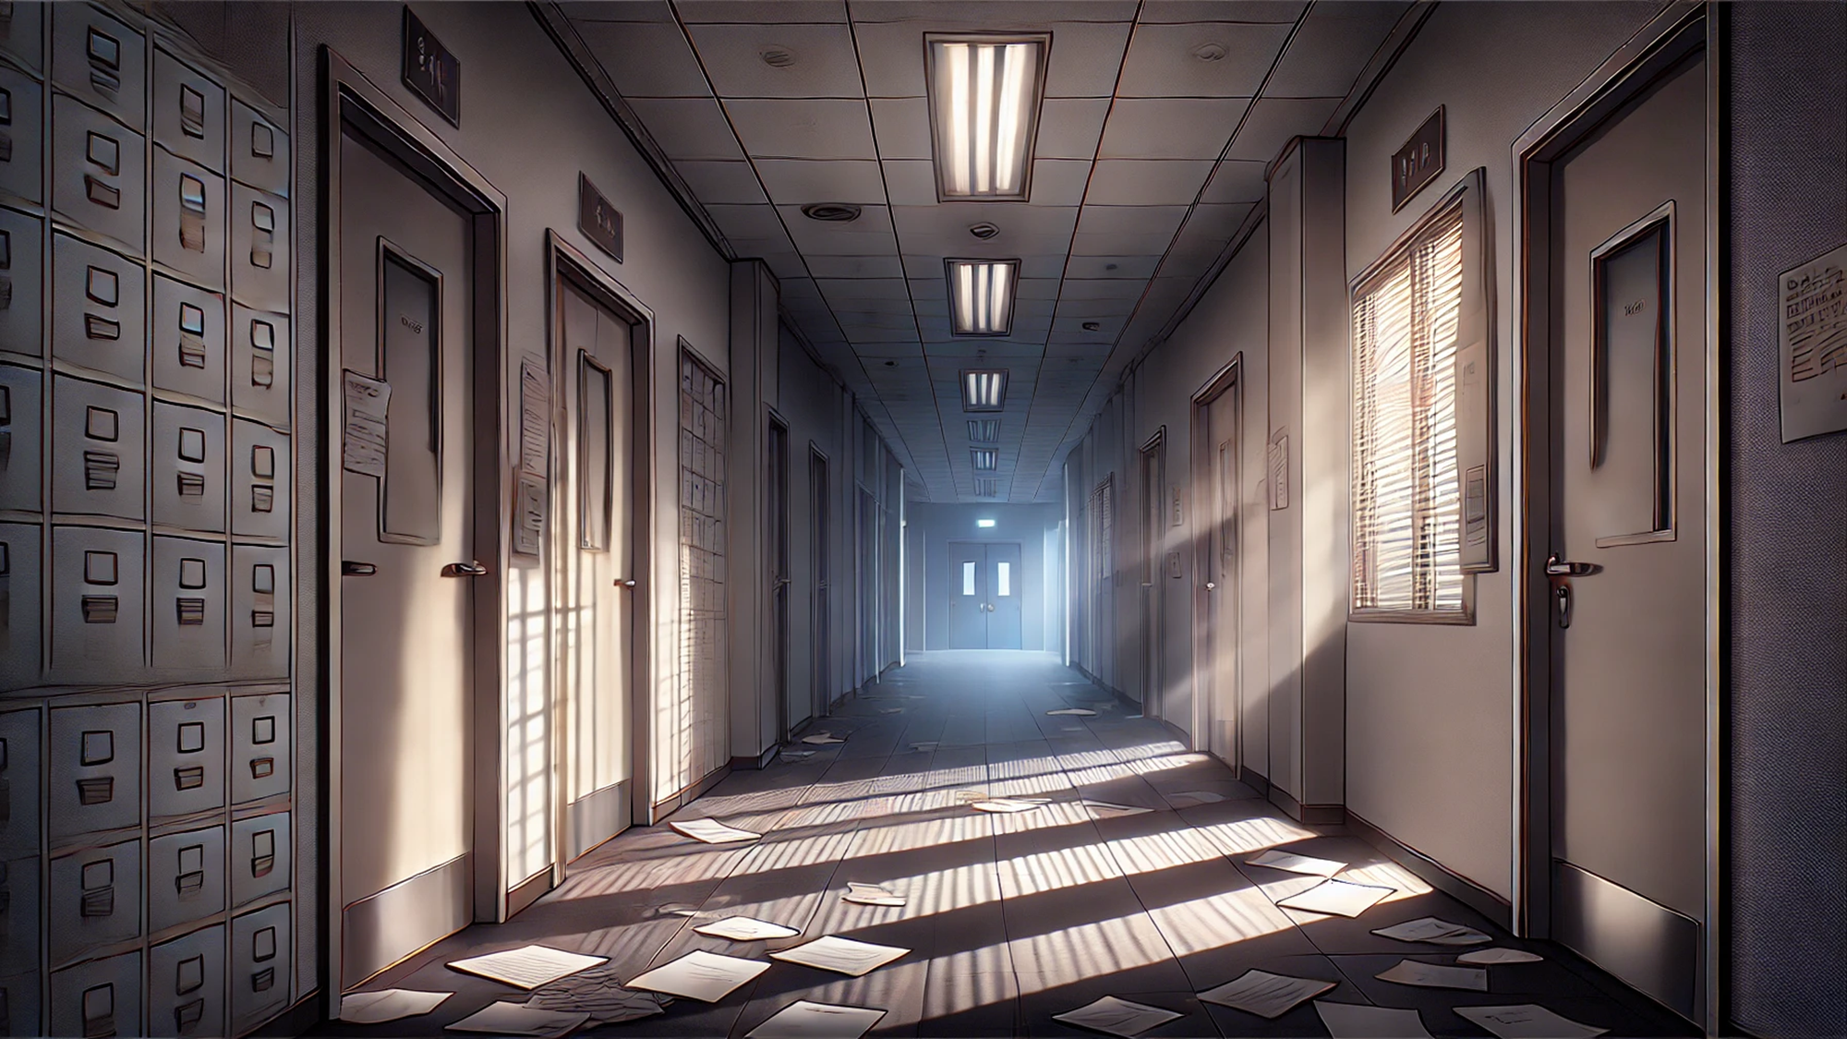
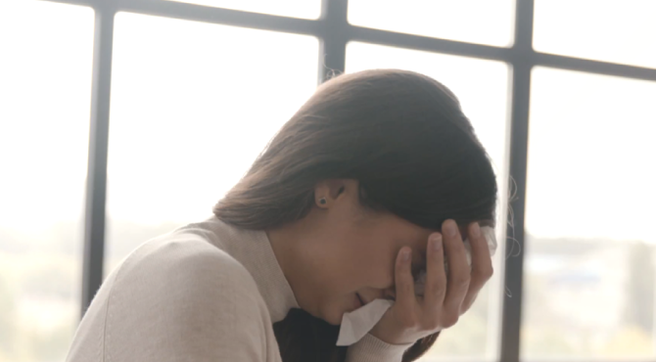
意外
Notes:
【Prompt】
A dimly lit, eerie hallway in an office or research facility, with a foreboding, abandoned atmosphere. The corridor is lined with closed doors on either side, and the floor is scattered with loose papers, as if hastily left behind. Sunlight streams in through partially opened blinds on one of the doors, casting long shadows across the tiled floor and adding a stark contrast to the otherwise dark setting. The overhead fluorescent lights are flickering, adding to the unsettling feeling. Filing cabinets are stacked along the wall, suggesting this may have once been a place of intense activity or secrecy, now quiet and deserted. The distant double doors at the end of the hall lead to an unknown area, amplifying the sense of mystery and tension.
【Context】
可就在此時，他的上司對他的判斷表示懷疑，這讓小白感到沮喪。
【Reference】
https://www.freepik.com/free-video/sad-woman-crying-while-sitting-sofa-home-1_171911#fromView=search&page=1&position=6&uuid=98076220-ea3a-414a-97a6-42cfb13f4efa

Slide 7
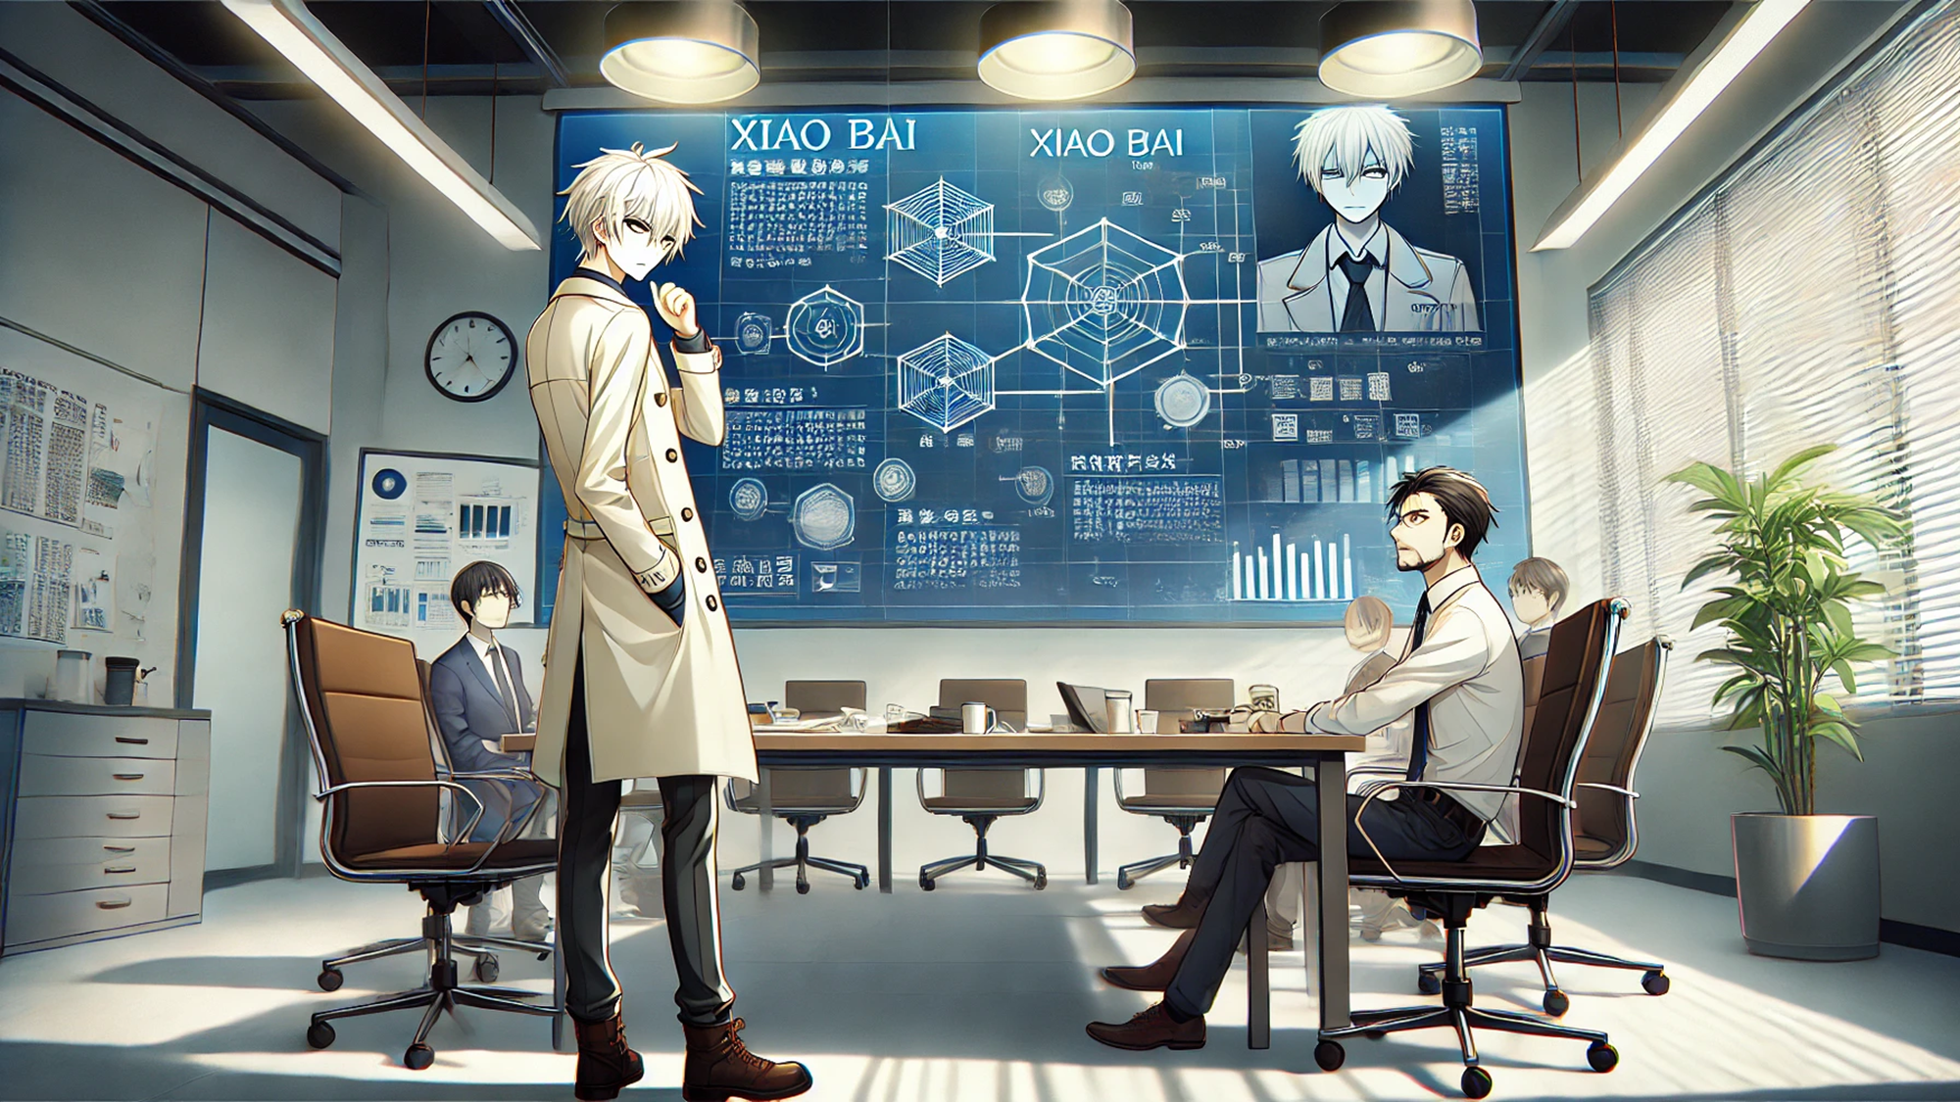
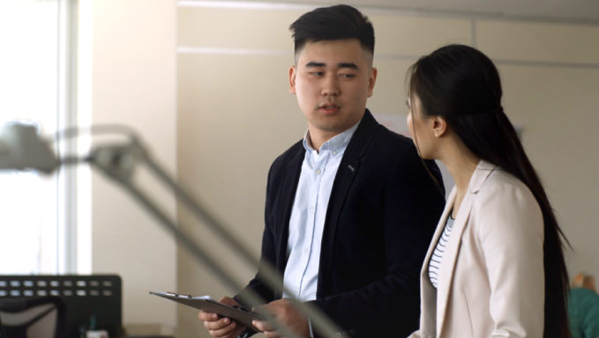
轉彎
Notes:
【Prompt】
An anime-style scene set in a modern, high-tech conference room where a group of professionals is engaged in a serious discussion. The central figure, a young male with silver hair in a stylish long coat, stands confidently with a thoughtful expression, his hand resting on his chin as he contemplates a problem. Behind him, a large digital display dominates the room, filled with intricate diagrams, data charts, and a profile of him labeled 'Xiao Bai.' The display showcases complex graphs and technical schematics, adding a sense of urgency and importance to the meeting. Other characters, seated around the conference table, are deep in thought or reviewing documents, contributing to the atmosphere of intense focus and collaboration. The room is lit by modern pendant lights, and large windows allow natural light to stream in, casting soft shadows on the sleek, professional setting.
【Context】
這時，他想起了在校園時的朋友小黑，於是決定主動請教上司，希望能找到解決問題的路徑。
【Reference】
https://www.freepik.com/free-video/two-young-colleagues-discussing-while-walking-office_170876#fromView=search&page=1&position=5&uuid=ffd81111-6d92-4158-8daa-b9a45cb341e8

Slide 8

結局
Notes:
【Prompt】
An anime-style group scene featuring a joyful gathering of friends in an outdoor setting, illuminated by warm, golden sunlight. The central character, a young male with silver hair and a bright smile, wears a casual hoodie with a vest, exuding a relaxed and cheerful vibe. Surrounding him are his friends, all smiling and laughing, dressed in a variety of outfits that reflect their personalities: from casual shirts and jackets to cute dresses and school uniforms. The atmosphere is lively and friendly, as they stand together under the shade of trees with sunlight filtering through the leaves. The background shows a peaceful park or garden with soft greenery, adding to the warm, carefree mood of the scene, which captures a perfect moment of camaraderie and happiness.
【Context】
這次職場的冒險讓小白深刻體會到，面對挑戰時的堅持與勇氣是多麼重要。他不僅在工作上獲得了認可，還結交了許多志同道合的朋友。
【Reference】
https://www.freepik.com/free-video/two-young-girls-young-boy-walk-happily-embraced-along-road-with-their-backs-each-other_1197269#fromView=search&page=1&position=0&uuid=b33fadca-2f9f-4bbc-b201-bc4825c3f0fd

Slide 9
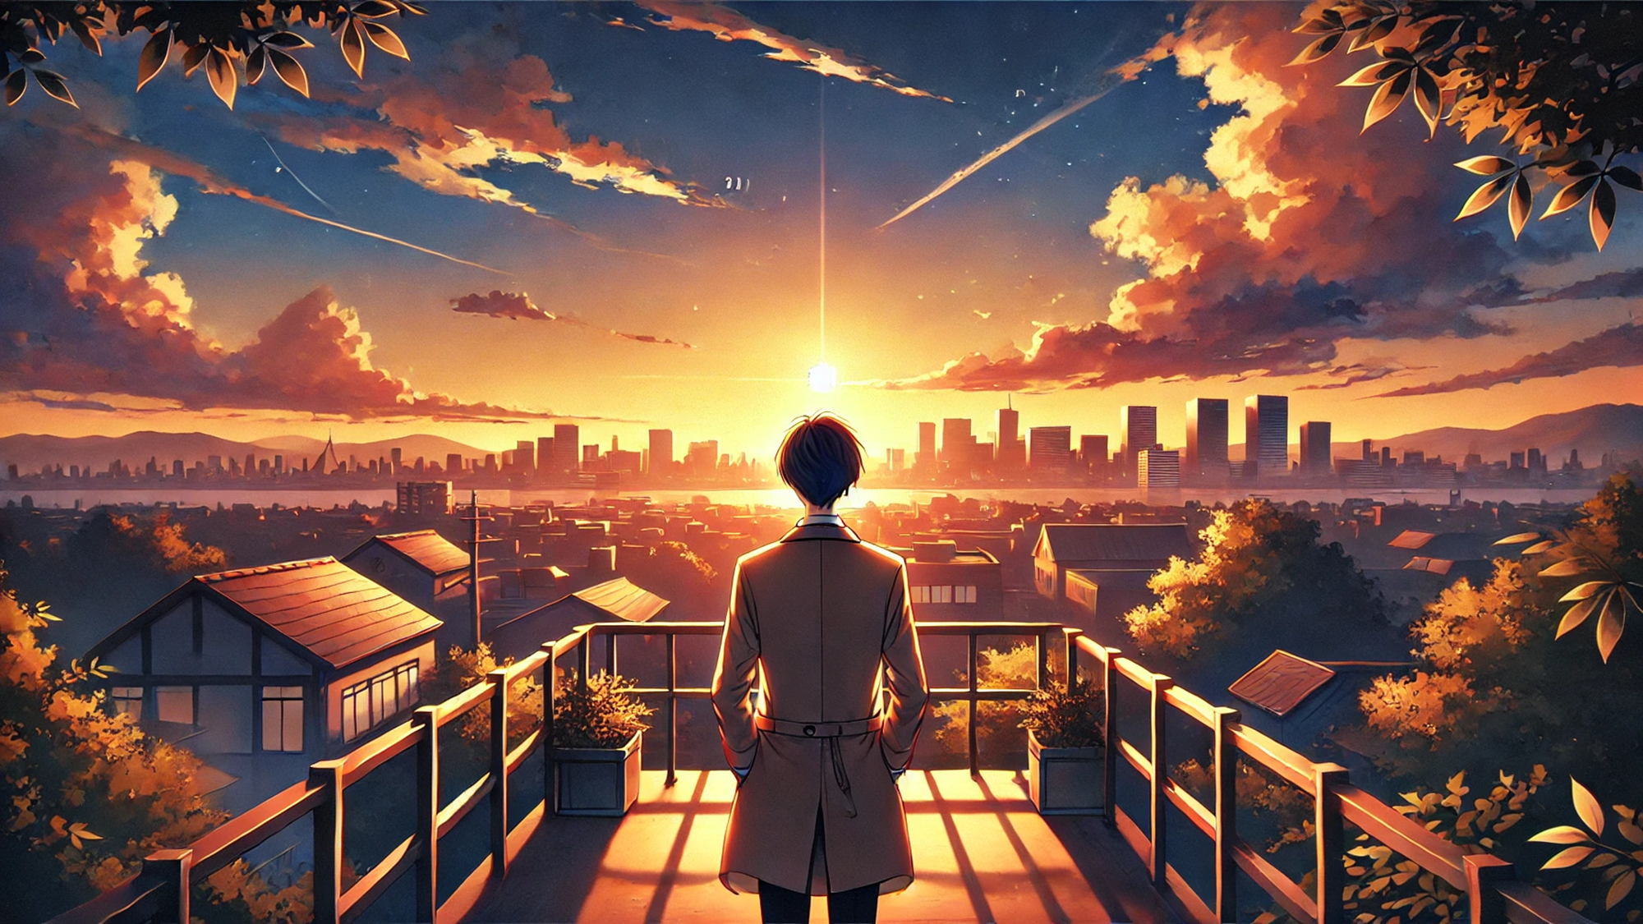
全劇終
Notes:
【Prompt】
An anime-style sunset scene where a young man, seen from behind, stands on a balcony overlooking a sprawling cityscape. The sky is painted with vibrant hues of orange, pink, and gold as the sun sets on the horizon, casting a warm glow across the entire scene. Wisps of clouds and streaks from distant airplanes stretch across the sky, adding depth and motion to the peaceful moment. Below, traditional rooftops blend with modern buildings, while in the distance, skyscrapers rise against the backdrop of distant mountains. The balcony is surrounded by potted plants, and the figure wears a long coat, gazing out contemplatively as the sunlight bathes the landscape. The overall mood is serene and reflective, capturing a quiet, introspective moment at the end of the day.
【Context】
【Reference】

